Slide 1
Apache Kafka (Message Queue) with Code
-By Praveen
- By Praveen

Slide 2

Agenda
Apache Kafka introduction
Messaging system
Apache Kafka as a Message system
Apache Kafka Architecture
Apache Kafka Work flow
Apache kafka Core API
Apache kafka Components
Apache kafka Use cases
RabbitMQ Vs Kafka
Implementation Code
- By Praveen

Slide 3
Apache Kafka introduction
Apache Kafka is a software platform which is based on a distributed streaming process.
It is a publish-subscribe messaging system which let exchanging of data between applications, servers, and processors as well.
Apache Kafka was originally developed by LinkedIn in 2010, and later it was donated to the Apache Software Foundation. Currently, it is maintained by Confluent under Apache Software Foundation.
In the year 2011 Kafka was made public.
Kafka works well as a replacement for a more traditional message broker.
Apache Kafka has resolved the lethargic trouble of data communication between a sender and a receiver.
- By Praveen

Slide 4
Agenda
Apache Kafka introduction
Messaging system
Apache Kafka as a Message system
Apache Kafka Architecture
Apache Kafka Work flow
Apache kafka Core API
Apache kafka Components
Apache kafka Use cases
RabbitMQ Vs Kafka
Implementation Code
- By Praveen

Slide 5
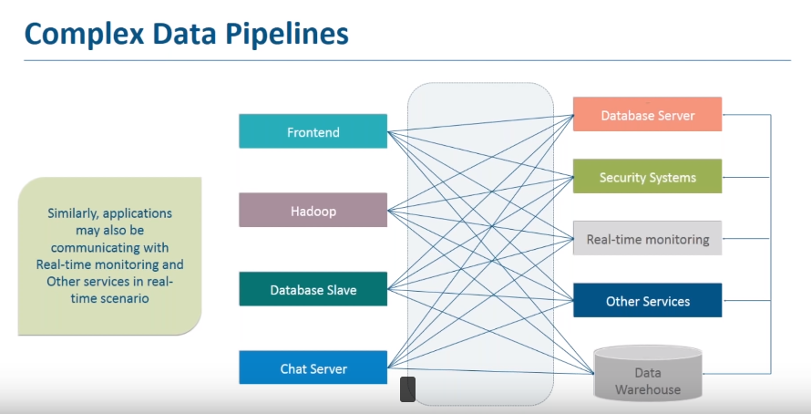
- By Praveen

Slide 6
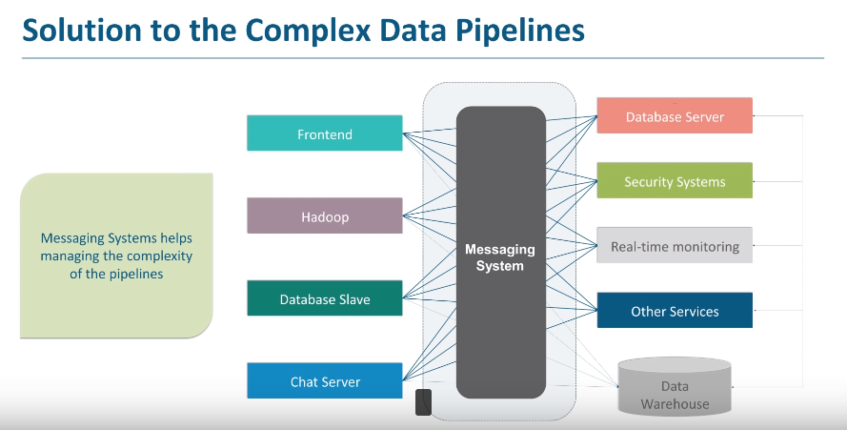
- By Praveen

Slide 7
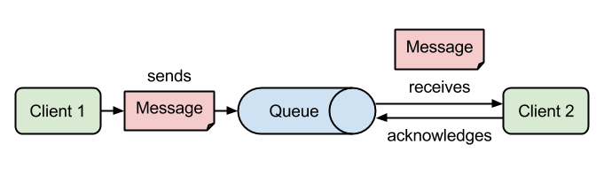
Messaging System
There are two types of Messaging System:
Point to Point System
Publish-Subscribe System
1. Point to Point System
Messages are persisted in a queue, but a particular message can be consumed by a maximum of one consumer only. Once a consumer reads a message in the queue, it disappears from that queue.
The typical example of this system is an Order Processing System, where each order will be processed by one Order Processor, but Multiple Order Processors can work as well at the same time. The following diagram depicts the structure.
- By Praveen

Slide 8
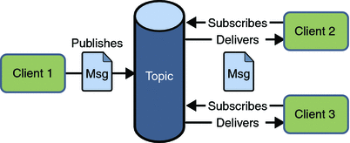
Messaging System
2. Publish-Subscribe System
Messages are persisted in a topic. Unlike point-to-point system, consumers can subscribe to one or more topic and consume all the messages in that topic. In the Publish-Subscribe system, message producers are called publishers and message consumers are called subscribers.
A real-life example is Dish TV, which publishes different channels like sports, movies, music, etc., and anyone can subscribe to their own set of channels and get them whenever their subscribed channels are available.
- By Praveen

Slide 9
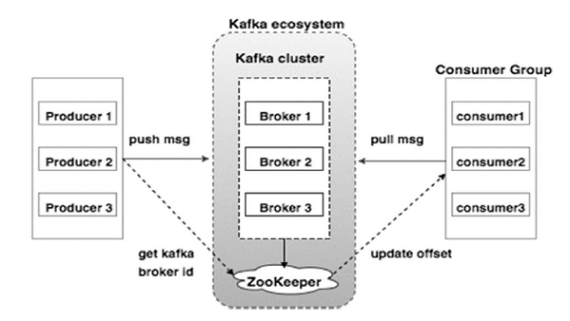
Apache Kafka as a Messaging System
- By Praveen

Slide 10
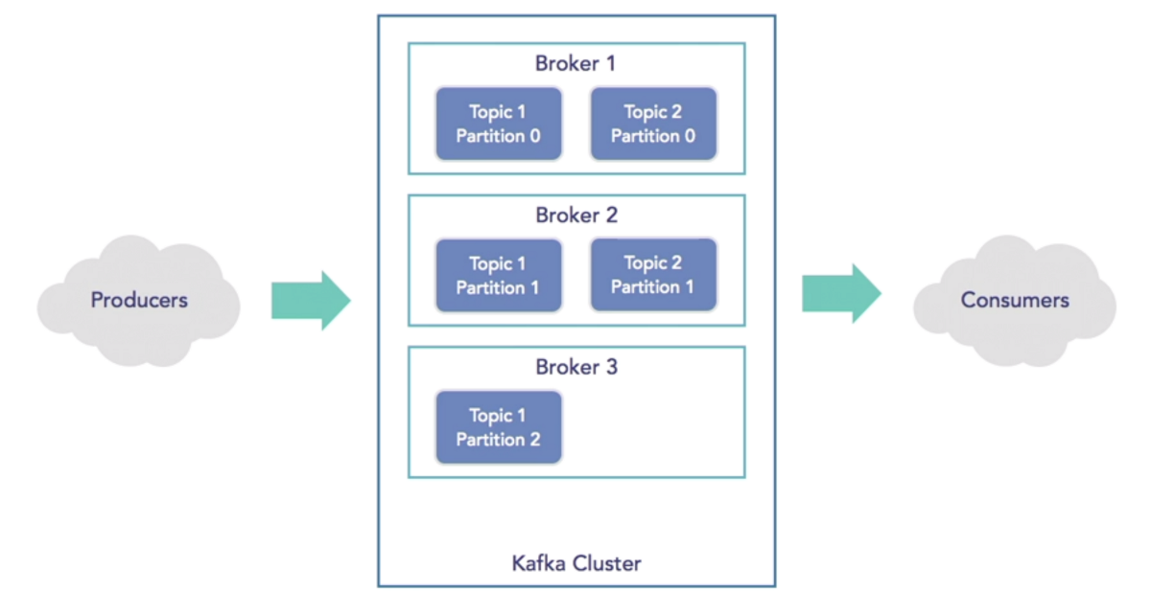
Apache Kafka Architecture
- By Praveen

Slide 11
Apache Kafka Architecture Cont...
Kafka is a distributed, replicated commit log. Kafka does not have the concept of a queue which might seem strange at first, given that it is primary used as a messaging system. Queues have been synonymous with messaging systems for a long time. Let’s break down “distributed, replicated commit log” a bit:
Distributed because Kafka is deployed as a cluster of nodes, for both fault tolerance and scale
Replicated because messages are usually replicated across multiple nodes (servers).
Kafka is so powerful regarding throughput and scalability that it allow you to handle continuous stream of messages.
Commit Log because messages are stored in partitioned, append only logs which are called Topics. This concept of a log is the principal killer feature of Kafka.
- By Praveen

Slide 12
Apache Kafka Work Flow
Following is the step wise workflow of the Pub-Sub Messaging −
Producers send message to a topic at regular intervals.
Kafka broker stores all messages in the partitions configured for that particular topic. It ensures the messages are equally shared between partitions. If the producer sends two messages and there are two partitions, Kafka will store one message in the first partition and the second message in the second partition.
Consumer subscribes to a specific topic.
Once the consumer subscribes to a topic, Kafka will provide the current offset of the topic to the consumer and also saves the offset in the Zookeeper.
Consumer will request the Kafka in a regular interval (like 100 Ms) for new messages.
Once Kafka receives the messages from producers, it forwards these messages to the consumers.
Consumer will receive the message and process it.
Once the messages are processed, consumer will send an acknowledgement to the Kafka broker.
Once Kafka receives an acknowledgement, it changes the offset to the new value and updates it in the Zookeeper. Since offsets are maintained in the Zookeeper.
This above flow will repeat until the consumer stops the request.
Consumer has the option to rewind/skip to the desired offset of a topic at any time and read all the subsequent messages
- By Praveen

Slide 13
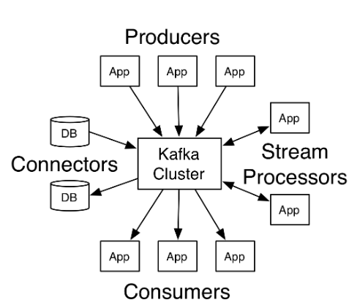
Apache Kafka Core API
The Producer API allows an application to publish a stream of records to one or more Kafka topics.
The Consumer API allows an application to subscribe to one or more topics and process the stream of records produced to them.
The Streams API allows an application to act as a stream processor, consuming an input stream from one or more topics and producing an output stream to one or more output topics, effectively transforming the input streams to output streams.
The Connector API allows building and running reusable producers or consumers that connect Kafka topics to existing applications or data systems. For example, a connector to a relational database might capture every change to a table.
- By Praveen

Slide 14
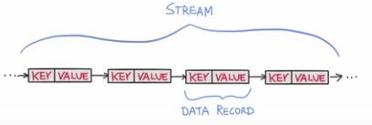
What is Streams
Think of s Stream as an infinite. Continuous real-time flow of data.
data are a key-value pairs.
In Kafka stream API transform and increases data.
- Support per-record stream processing with milisecond.
- By Praveen

Slide 15
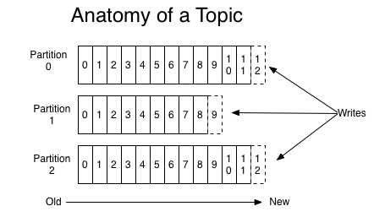
Kafka Components
Using the following components, Kafka achieves messaging:
1. Topic
Basically, A Topic is a unique name for Kafka Stream. Topic is a category or feed name to which records are published, and stores messages. Topics in Kafka are always multi-subscriber; that is, a topic can have zero, one, or many consumers that subscribe to the data written to it.
Each partition is an ordered, immutable sequence of records that is continually appended to—a structured commit log. The records in the partitions are each assigned a sequential id number called the offset that uniquely identifies each record within the partition.
- By Praveen

Slide 16
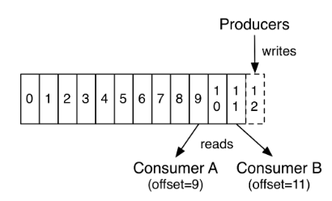
Kafka Components
The Kafka cluster durably persists all published records—whether or not they have been consumed—using a configurable retention period. For example, if the retention policy is set to two days, then for the two days after a record is published, it is available for consumption, after which it will be discarded to free up space. Kafka's performance is effectively constant with respect to data size so storing data for a long time is not a problem.
This is one of the biggest difference between RabbitMQ/ActiveMQ and Kafka.
- By Praveen

Slide 17
Kafka Components
2. Kafka Producer
It publishes messages to a Kafka topic. The producer is responsible for choosing which record to assign to which partition within the topic.
3. Kafka Consumer
This component subscribes to a topic(s), reads and processes messages from the topic(s).
4. Kafka Broker
Kafka Broker manages the storage of messages in the topic(s). If Kafka has more than one broker, that is what we call a Kafka cluster.
5. Kafka Zookeeper
To offer the brokers with metadata about the processes running in the system and to facilitate health checking and managing and coordinating, Kafka uses Kafka zookeeper.
- By Praveen

Slide 18
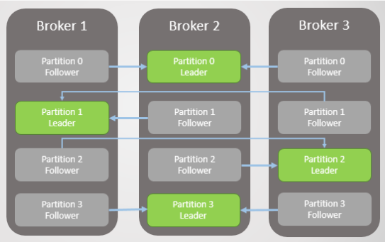
Kafka Components
Partitions for the same topic are distributed
across multiple brokers in the cluster.
Partitions are replicated across multiple servers;
number of replicas is a configurable parameter.
Each Partition has one server as a leader and
a number of servers as followers.
Each Server acts a leader for some of its partitions
and as a follower for some other.
The Producers are responsible for choosing which
message to assign to which partition within the topic based on key assigned to message.
- By Praveen

Slide 19
Kafka Use Cases
There are several use Cases of Kafka that show why we actually use Apache Kafka.
Messaging
For a more traditional message broker, Kafka works well as a replacement. We can say Kafka has better throughput, built-in partitioning, replication, and fault-tolerance which makes it a good solution for large-scale message processing applications.
Metrics
For operational monitoring data, Kafka finds the good application. It includes aggregating statistics from distributed applications to produce centralized feeds of operational data.
Event Sourcing
Since it supports very large stored log data, that means Kafka is an excellent backend for applications of event sourcing.
- By Praveen

Slide 20
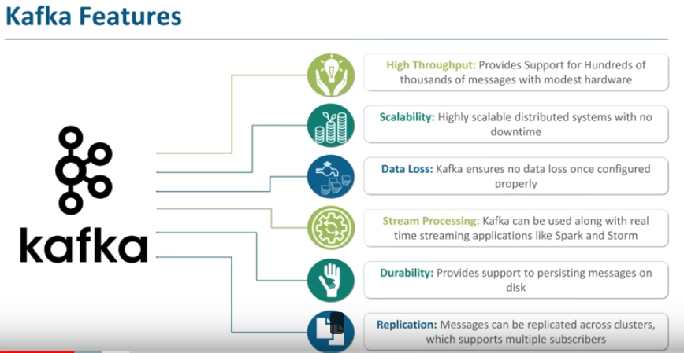
- By Praveen

Slide 21
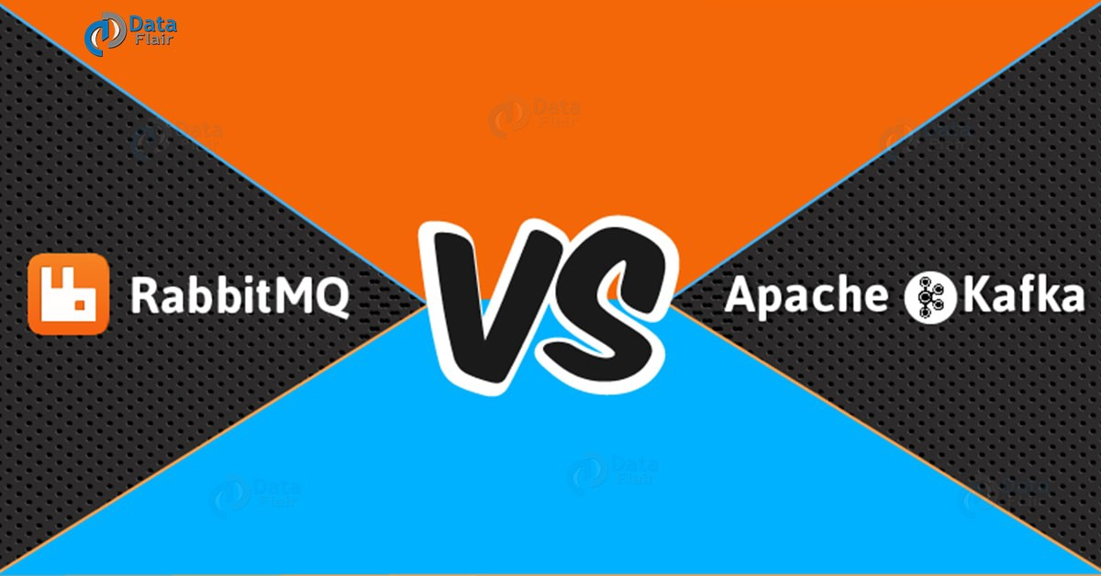
- By Praveen

Slide 22
RabbitMQ Vs Kafka
Let’s see how they differ from one another:
i. Features
Apache Kafka– Basically, Kafka is distributed. Also, with guaranteed durability and availability, the data is shared and replicated.
RabbitMQ– It offers relatively less support for these features.
ii. Performance rate
Apache Kafka — Its performance rate is high to the tune of 100,000 messages/second.
RabbitMQ — Whereas, the performance rate of RabbitMQ is around 20,000 messages/second.
iii. Processing
Apache Kafka — It allows reliable log distributed processing. Also, stream processing semantics built into the Kafka Streams.
RabbitMQ — Here, the consumer is just FIFO based, reading from the HEAD and processing 1 by 1.
iv. Replay
When your application needs access to stream history, delivered in partitioned order at least once. Kafka is a durable message store and clients can get a “replay” of the event stream on demand, as opposed to more traditional message brokers where once a message has been delivered, it is removed from the queue.
- By Praveen

Slide 23
Implementation of Kafka
Dependency uses:
<dependency>
<groupId>org.springframework.kafka</groupId>
<artifactId>spring-kafka</artifactId>
</dependency>
- By Praveen

Slide 24
Implementation of Kafka
Define the KafkaSender class to send message to the kafka topic named as developervisits-topic:
import org.springframework.beans.factory.annotation.Autowired;
import org.springframework.kafka.core.KafkaTemplate;
import org.springframework.stereotype.Service;
@Service
public class KafkaSender {
@Autowired
private KafkaTemplate<String, String> kafkaTemplate;
String kafkaTopic = "developervisits-topic";
public void send(String message) {
kafkaTemplate.send(kafkaTopic, message);
}
}
- By Praveen

Slide 25
Implementation of Kafka
Define a Controller which will pass the message and trigger the send message to the Kafka Topic using the KafkaSender class.
import org.springframework.beans.factory.annotation.Autowired;
import org.springframework.web.bind.annotation.GetMapping;
import org.springframework.web.bind.annotation.RequestMapping;
import org.springframework.web.bind.annotation.RequestParam;
import org.springframework.web.bind.annotation.RestController;
import com.hcl.service.KafkaSender;
@RestController
@RequestMapping(value = "/developervisits-kafka/")
public class ApacheKafkaWebController {
@Autowired
KafkaSender kafkaSender;
@GetMapping(value = "/producer")
public String producer(@RequestParam("message") String message) {
kafkaSender.send(message);
return "Message sent to the Kafka Topic developervisits-topic Successfully";
}
}
- By Praveen

Slide 26
Implementation of Kafka
Finally Define the Spring Boot Class with @SpringBootApplication annotation
import org.springframework.boot.SpringApplication;
import org.springframework.boot.autoconfigure.SpringBootApplication;
@SpringBootApplication
public class SpringBootHelloWorldApplication {
public static void main(String[] args) {
SpringApplication.run(new Object[] {
SpringBootHelloWorldApplication.class
}, args);
}
}
- By Praveen

Slide 27
Implementation of Kafka
We are done with the required Java code. Now lets start Apache Kafka. As we had explained in detail in the Getting started with Apache Kafka perform the following.
Download the Apache Kafka from this link:
https://kafka.apache.org/downloads
Start Apache Zookeeper-
zookeeper-server-start.bat c:\shareData\development\appachekafka\kafka_2.12-2.0.0\config\zookeeper.properties
Start Apache Kafka-
kafka-server-start.bat c:\shareData\development\appachekafka\kafka_2.12-2.0.0\config\server.properties
- By Praveen

Slide 28
Implementation of Kafka
Next start the Spring Boot Application by running it as a Java Application.
CREATE TOPIC ON KAFKA SERVER
Also Start the consumer listening to the developervisits-topic
kafka-topics.bat --create --zookeeper localhost:2181 --replication-factor 1 --partitions 1 --topic developervisits-topic
PRODUCER
kafka-console-producer.bat --broker-list localhost:9092 --topic developervisits-topic
-OR-
http://localhost:8080/developervisits-kafka/producer?message="test"
CONSUMER
kafka-console-consumer.bat --bootstrap-server localhost:9092 --topic developervisits-topic --from-beginning
- By Praveen

Slide 29
Questions
- By Praveen

